Slide 1
REACT DASHBOARD
-Maheshwari R
Jeppiaar Engineering College

Slide 2
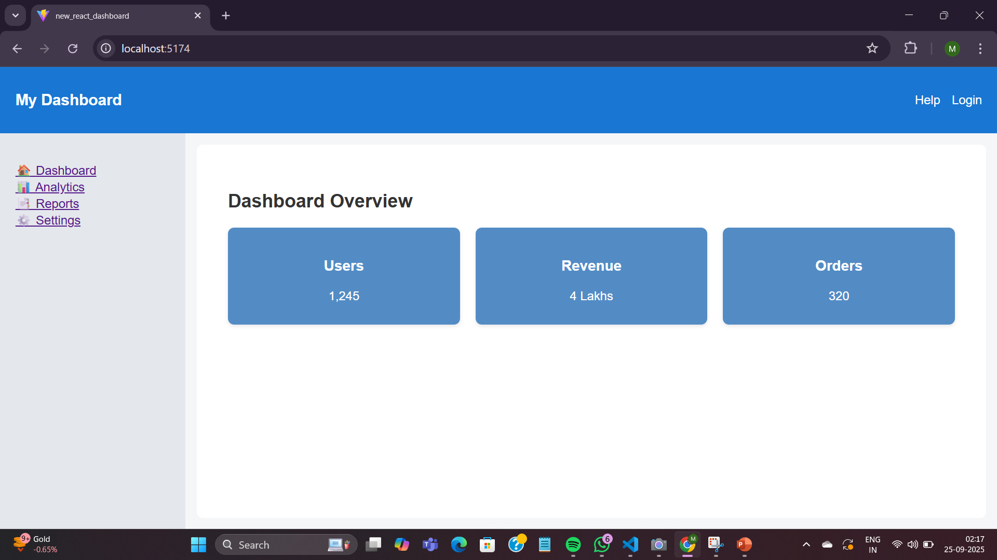
MY DASHBOARD
This is a React-based Dashboard Application built to demonstrate frontend development skills using React, reusable components, routing, charts, and a mock REST API.
Tech Stack:
ReactJS
React Router DOM (for navigation)
Chart.js + React-Chartjs-2 (for charts)
CSS (for styling)

Slide 3
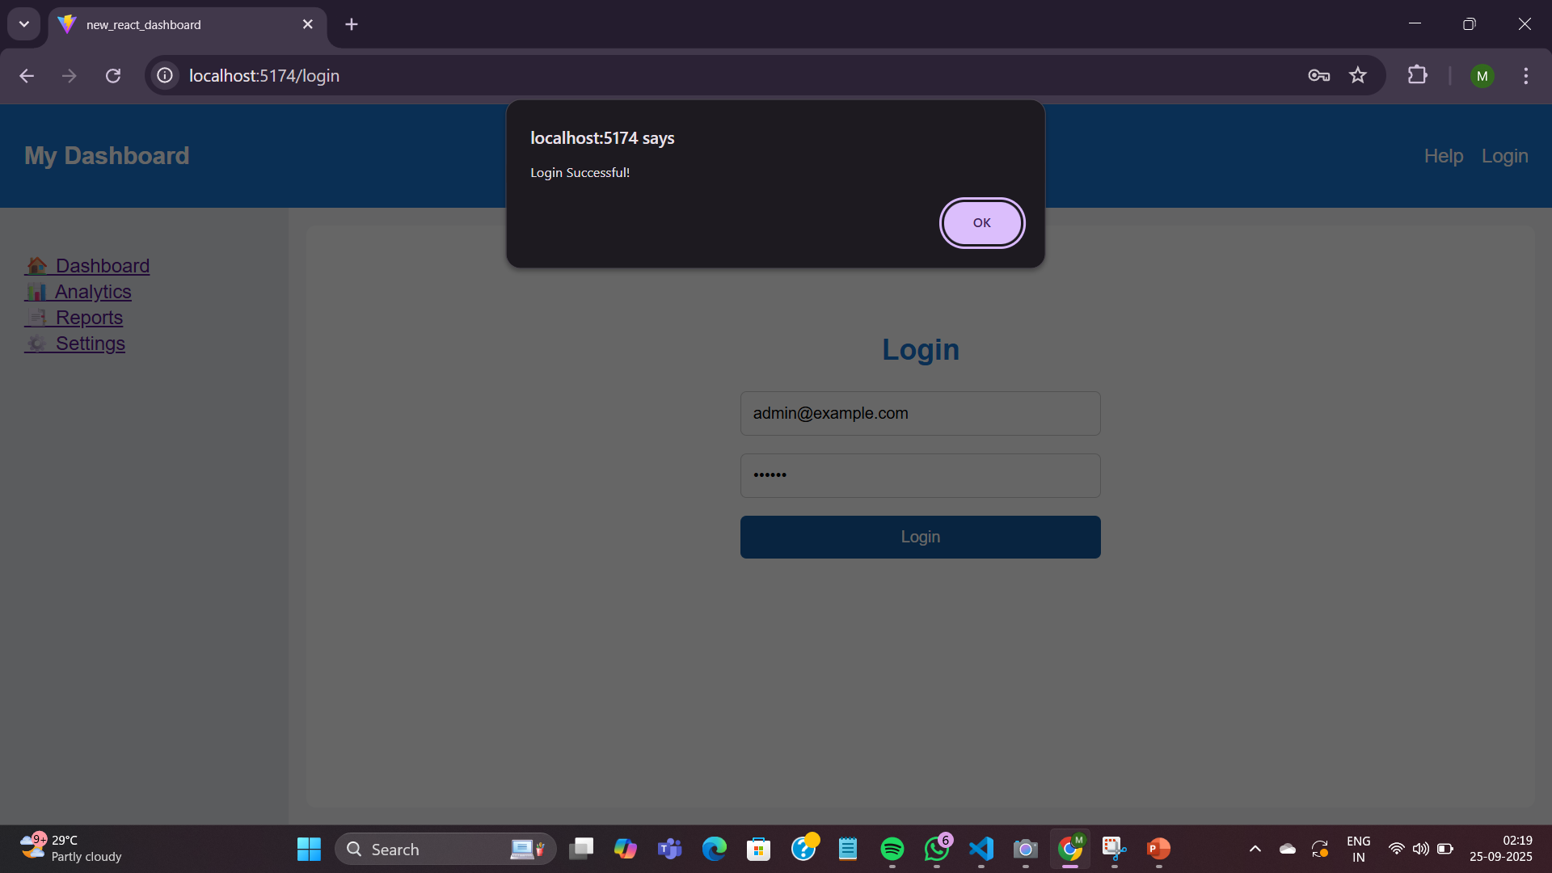
LOGIN (Navbar)
The Navbar is a fixed component that stays at the top of the page, giving consistent access to navigation options across all pages of the dashboard.
Navbar → Branding, Help, Login
LOGIN:
The Login page is a simple form where users can enter:
Email / Username
Password
Purpose: Demonstrates form handling and state management in React.

Slide 4
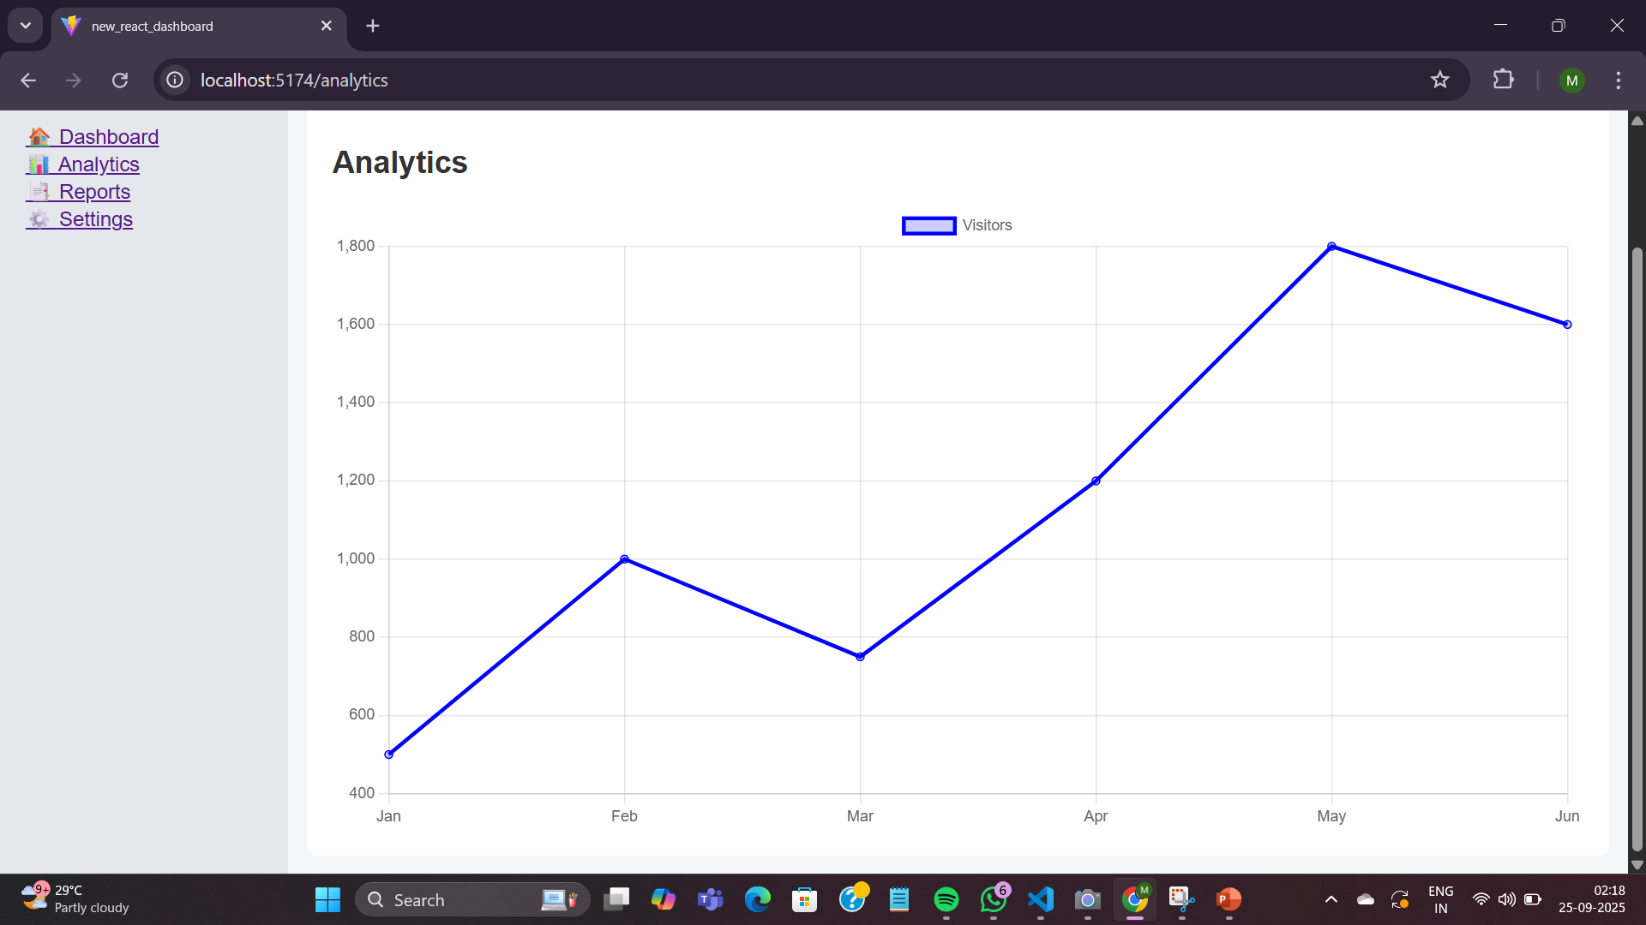
ANALYTICS (Sidebar)
Displays data visualization for dashboard metrics. Uses Line Chart from Chart.js via react-chartjs-2.
Charts are interactive and responsive.
Demonstrates integration of third-party libraries in React.
Helps users quickly understand key metrics visually.

Slide 5
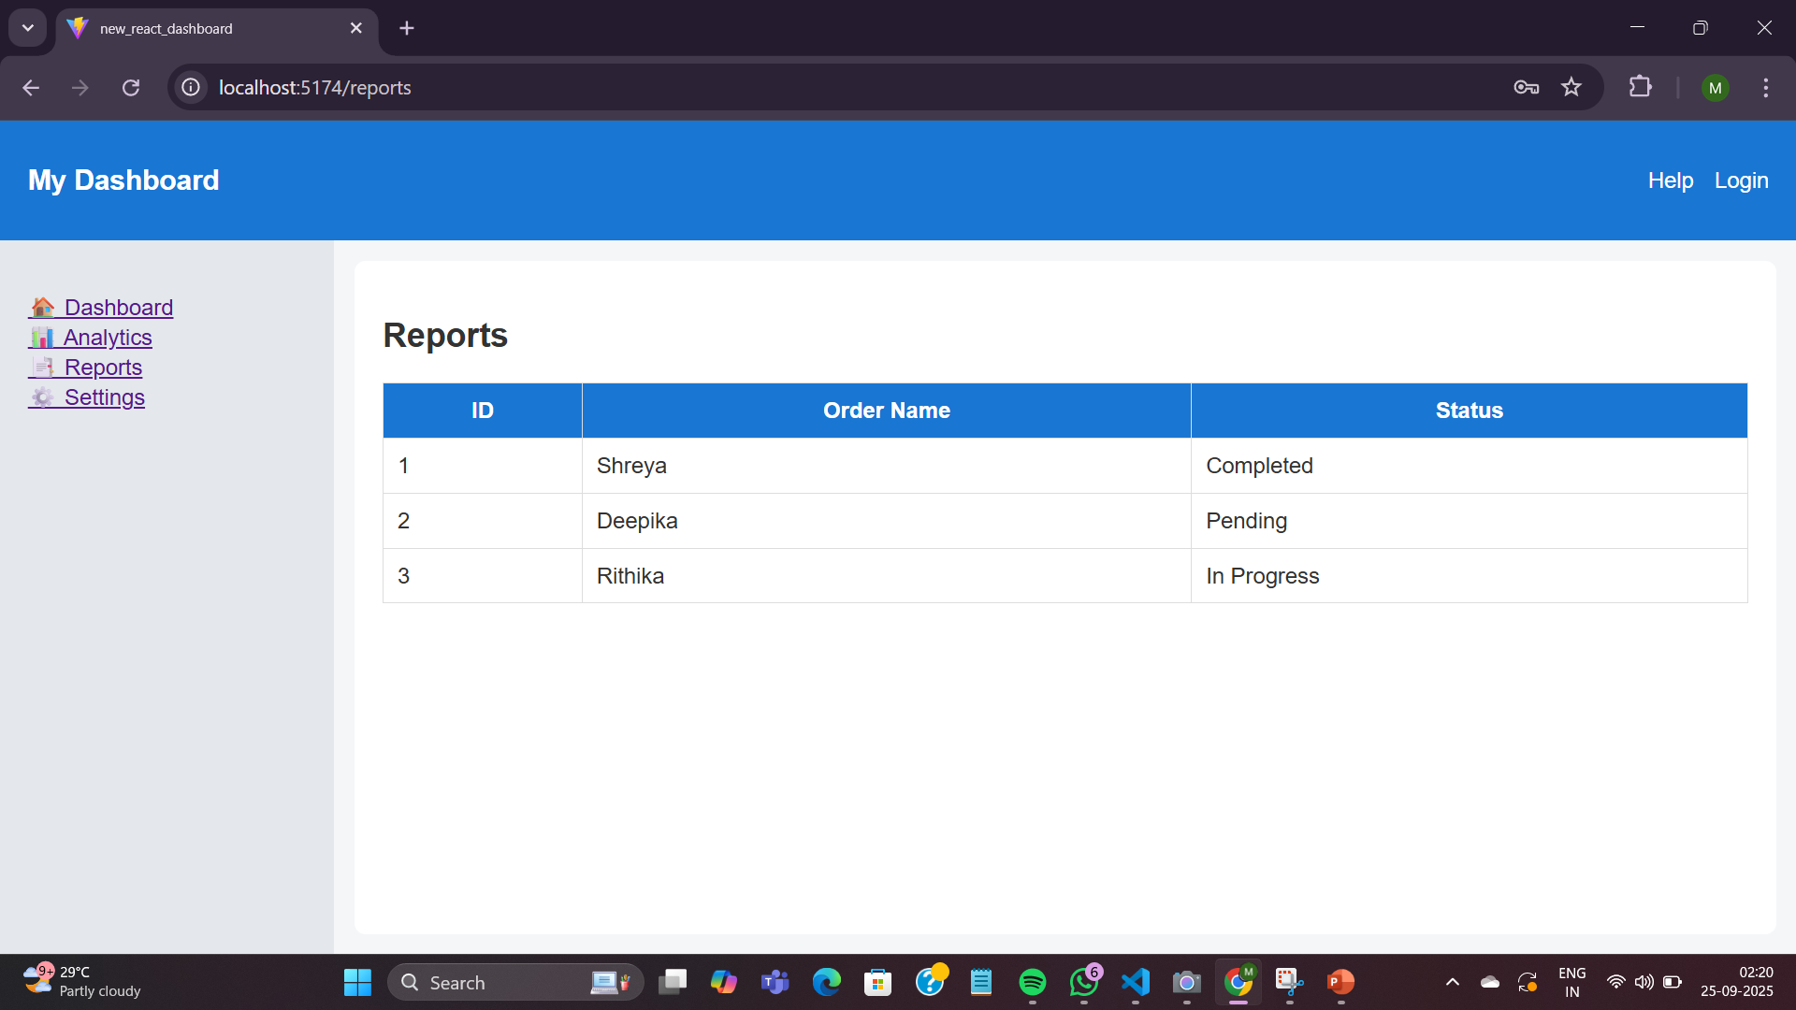
REPORTS (Sidebar)
Displays tabular data for reports. Uses HTML table styled with CSS.
Demonstrates dynamic rendering using map() in React.
Useful for tracking project/report status visually.
Gives understanding of component structure and UI layout.

Slide 6
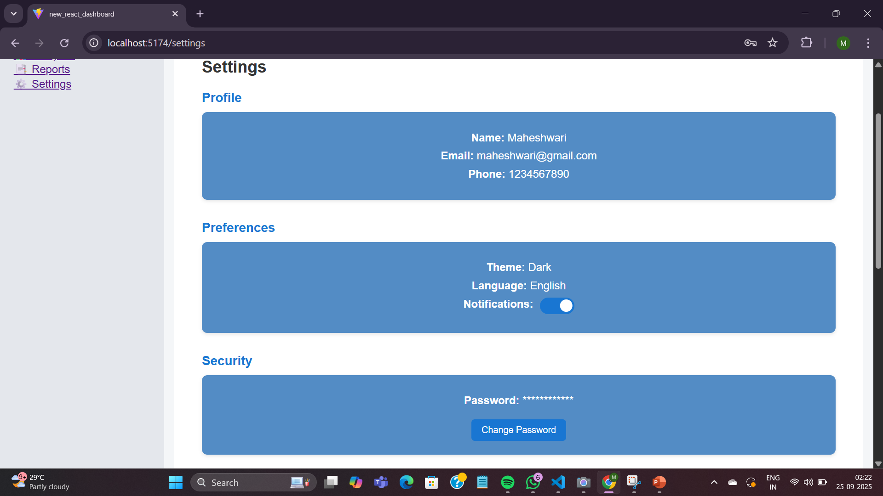
SETTINGS (Sidebar)
Contains sections: Profile, Preferences, Security
Profile → Shows user details (name, email).
Preferences → Can include theme, notifications.
Security → Options like password reset.
Demonstrates structured page layout and reusable components.
Shows understanding of stateful vs static components in React.

Slide 7
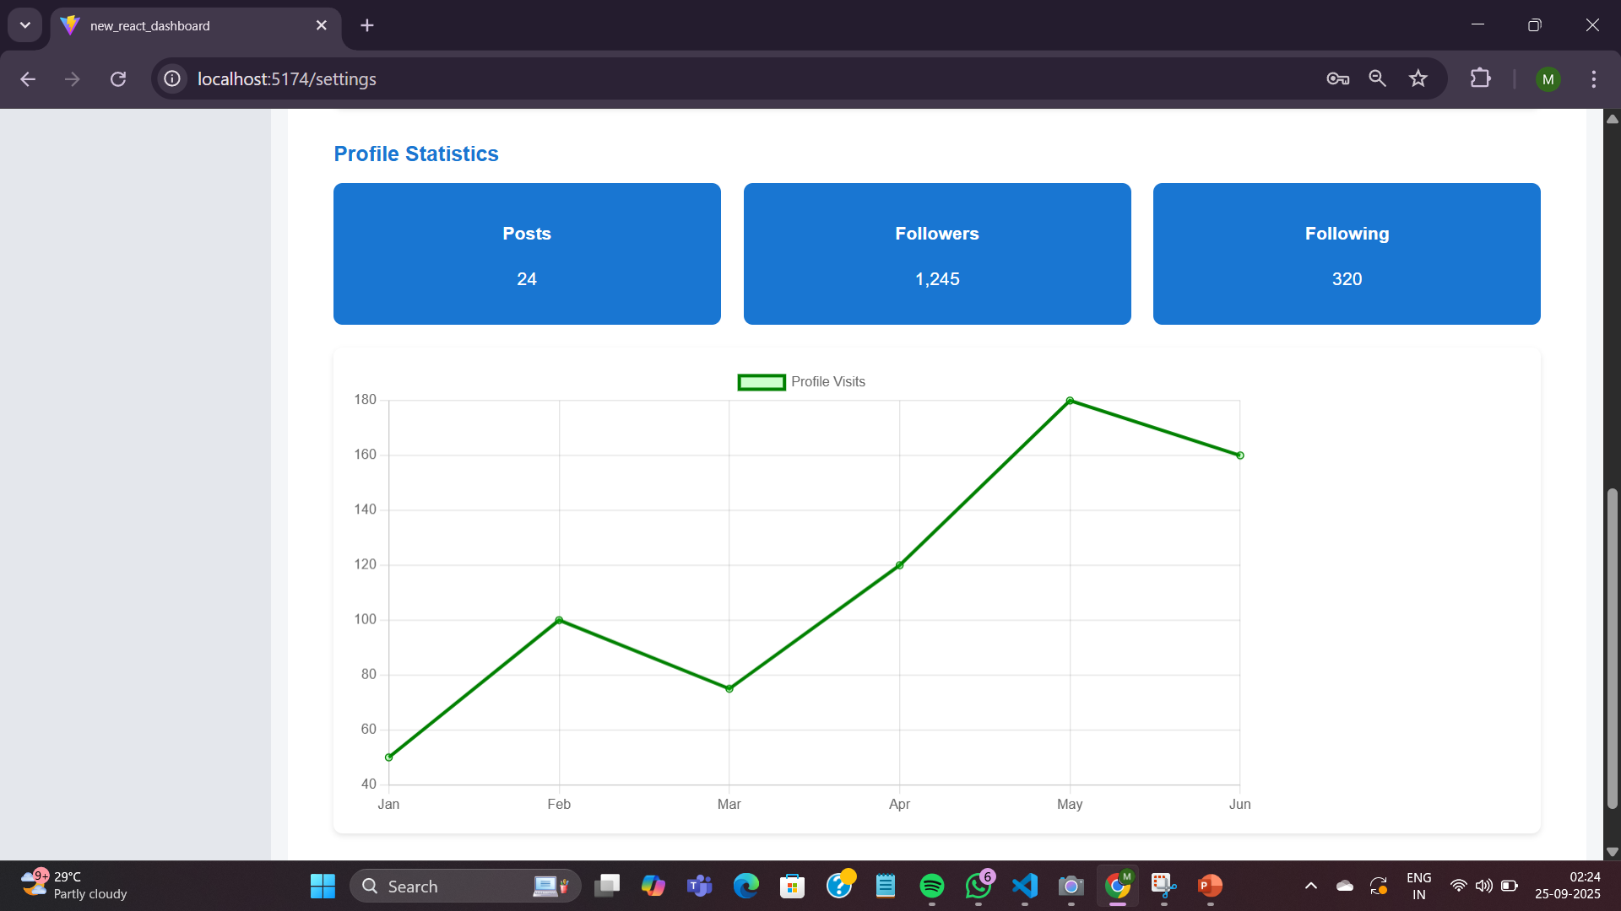
PROFILE STATISTICS (Sidebar)
Displays key user metrics in card format:
Total Users
Active Users
Revenue / Orders
Built using reusable Card component in React.
Demonstrates component reusability and clean UI layout.
Helps users quickly view important statistics at a glance.

Slide 8
THANK YOU

